Slide 1
Software Design for Cloud 3
Python Programming
Lecture 1
Threading 1

Slide 2
Introducing Threads
A thread is a single sequential flow of control within a program.
Lightweight Process - like a process except shares instance variables
Execution Context - has its own execution stack and program counter

Slide 3
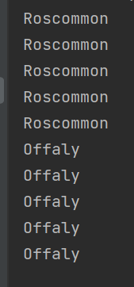
Non Threaded
def main(): # import time,sys
d1 = DisplayRoscommon()
d2 = DisplayOffaly()
d1.display()
d2.display()
class DisplayRoscommon():
def display(self):
for i in range(1,6):
sys.stdout.write('Roscommon\n')
time.sleep(1)
class DisplayOffaly():
def display(self):
for i in range(1,6):
sys.stdout.write('Offaly\n')
time.sleep(1)
main()

Slide 4
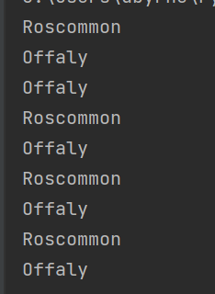
Multi- Threaded
from threading import *
import time
Import sys
def main():
d1 = DisplayRoscommon()
d2 = DisplayOffaly()
d1.start()
d2.start()
class DisplayRoscommon(Thread):
def run(self):
for i in range(1,6):
sys.stdout.write('Roscommon\n')
time.sleep(1)
class DisplayOffaly(Thread):
def run(self):
for i in range(1,6):
sys.stdout.write('Offaly\n')
time.sleep(1)

Slide 5
Note:
We use:
import sys
sys.stdout.write('Roscommon\n’)
Instead of:
print(‘Roscommon\n’)
To avoid issues relating to flushing the print buffer

Slide 6
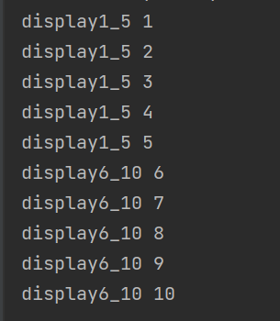
Non Threaded Example
def main():
d1 = Display1_5()
d2 = Display6_10()
d1.display()
d2.display()
class Display1_5():
def display(self):
for i in range(1,6):
print ('display1_5 {0}'.format(i))
class Display6_10():
def display(self):
for i in range(6,11):
print ('display6_10 {0}'.format(i))
main()
EX311

Slide 7
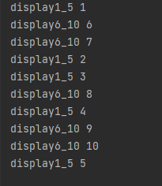
EX311 Rewrire Ex311.py using Thread
so the output looks like this

Slide 8
Q312. The C# application detailed below is single threaded and results in the output
as shown in Figure 1 below.
Rewrite the Main function using Threads to ensure that the incrementer and
decrementer functions run
concurrently and the resulting output is similar to that shown in Figure2.
def main():
d1 = Incrementer_1_9()
d2 = Decrementer_9_1()
d1.change()
d2.change()
class Incrementer_1_9():
def change(self):
for i in range(1,10):
sys.stdout.write('display1_5 ' + str(i) + "\n")
time.sleep(1)
class Decrementer_9_1():
def change(self):
for i in range(9,0,-1):
sys.stdout.write('display6_10 ' + str(i) + "\n")
time.sleep(1)

Slide 9
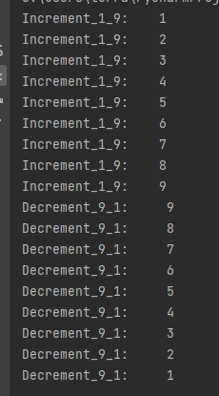
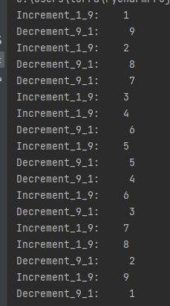
Q. continued
Figure 1 Figure 2

Slide 10
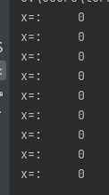
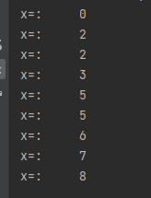
Q313. Rewrite the Main function using Threads to ensure that the WriteX and StepX functions
run concurrently and the resulting output is similar to that shown in Figure2.
Before
After (Figure2)
x=0
def main():
global x
d1 = StepX()
d2 = PrintX()
d2.print()
d1.step()

Slide 11
Alternative Approach:
Delegating Running of a Thread to a function
- Does not require Classes

Slide 12
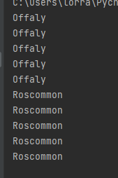
Example: Delegating Running of a Thread to a function
def main():
displayOffaly()
displayRoscommon()
def displayRoscommon():
for i in range(1,6):
sys.stdout.write('Roscommon\n')
time.sleep(1)
def displayOffaly():
for i in range(1,6):
sys.stdout.write('Offaly\n')
time.sleep(1)
main()

Slide 13
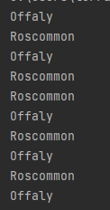
Solution
def main():
t1= Thread(target=displayOffaly)
t2= Thread(target=displayRoscommon)
t1.start()
t2.start()
def displayRoscommon():
for i in range(1,6):
sys.stdout.write('Roscommon\n')
time.sleep(1)
def displayOffaly():
:

Slide 14
Q314. Rewrite the Main function using Threads to ensure that the WriteX and StepX functions
run concurrently and the resulting output is similar to that shown in Figure2.
USE DELEGATION METHOD
Before
After (Figure2)
x=0
def main():
global x
d1 = StepX()
d2 = PrintX()
d2.print()
d1.step()

Slide 15
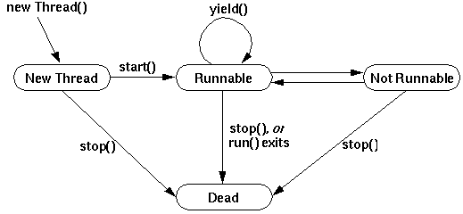
Thread State

Slide 16
Locking and Shared Data
X = 0
Thread 1
X = X + 1
Thread 2
X = X + 1
Result:
X = 1

Slide 17
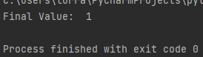
Locking and Shared Data
val1=0
def main():
global val1
t1 = Thread(target=go)
t2 = Thread(target=go)
t1.start()
t2.start()
t1.join()
t2.join()
print('Final Value: ',val1)
def go():
global val1
localVal1 = val1
localVal1 += 1
time.sleep(0.1)
val1 = localVal1

Slide 18
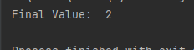
Solution
val1=0
lock = Lock()
def main():
global val1
t1 = Thread(target=go)
t2 = Thread(target=go)
t1.start()
t2.start()
t1.join()
t2.join()
print('Final Value: ',val1)
def go():
global val1,lock
lock.acquire()
localVal1 = val1
localVal1 += 1
time.sleep(0.1)
val1 = localVal1
lock.release()

Slide 19
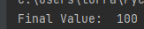

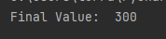
Ex315 The code is accesses shared Data & Gives Inconsistent Results
Res=0
def main():
global Res
t1 = Thread(target=step1)
t2 = Thread(target=step2)
t2.start()
t1.start()
t1.join()
t2.join()
print('Final Value: ',Res)
def step1():
global Res
localVal1 = Res
for i in range(1,101):
localVal1 +=1
time.sleep(0.02)
Res = localVal1
def step2():
global Res
localVal2 = Res
for i in range(1,101):
localVal2 +=2
time.sleep(0.02)
Res = localVal2
Rewrite using Lock to gve consistent Result

Slide 20
Ex316 The code is not Thread Safe & Gives Inconsistent Results
val1=9
val2=4
def main():
global val1,val2
t1 = Thread(target=calculate)
t2 = Thread(target=calculate)
t1.start()
t2.start()
t1.join()
t2.join()
def calculate():
global val1,val2
delay=0.1
if (val2!=0):
time.sleep(delay)
print('Res=',int(val1/val2))
delay=0.0001
else:
print('Cant Divide by 0')
val2 = 0

Slide 21
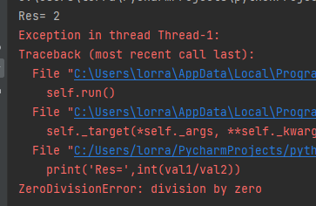
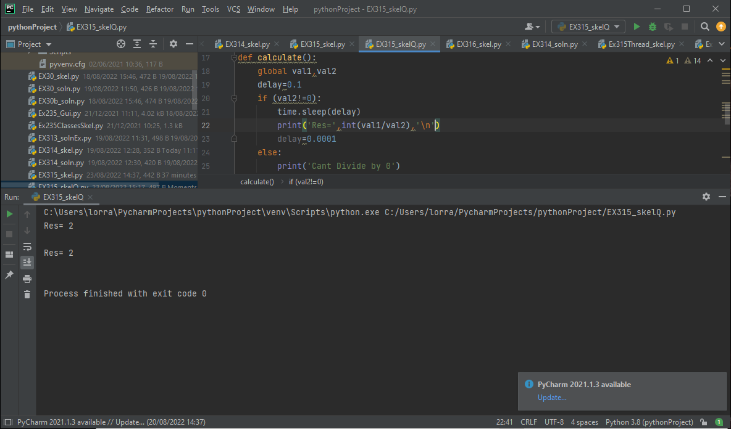
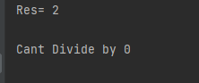
EX316 Gives These possible Results
Ex316 (a) Explain Why each of these results occur and
(b) show how to modify code using locks to get following result

Slide 22
EX316 (a) Answer
Thread 1
val1=9
val2=4
If (val2!=0)
delay
Print(9/4) = 2
val2=0
Thread 2
val1=9
val2=4
If (val2!=0)
delay
Print(9/0) = Err
val2=0
Thread 2
val1=9
val2=4
If (val2!=0)
delay
Print(9/4) = 2
Thread 1
val1=9
val2=4
If (val2!=0)
delay
Print(9/4) = 2
val2=0

Slide 23
Joining Threads
def main():
global val1
t1 = Thread(target=go)
t2 = Thread(target=go)
t1.start()
t2.start()
t1.join()
t2.join()
print('Final Value: ',val1)
Won’t Print final value until
t1 & t2 run to completion

Slide 24
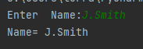
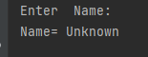
You can block until another thread ends by calling Join
name='Unknown'
def main():
global name
t1 = Thread(target=enterName)
t1.start()
t1.join()
print(‘\nName=',name)
def enterName():
global name
name = str(input('Enter Name:’))
main()
name='Unknown'
def main():
global name
t1 = Thread(target=enterName)
t1.start()
# t1.join()
print(‘\nName=',name)
def enterName():
global name
name = str(input('Enter Name:’))
main()

Slide 25
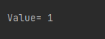
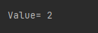
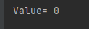
value=0
lock = Lock()
def main():
global value
t1 = Thread(target=increment)
t1.start()
t2 = Thread(target=increment)
t2.start()
#joins go here
print('\nValue=',value)
def increment():
global value, lock
lock.acquire()
tempValue = value + 1
time.sleep(1)
value = tempValue
lock.release()
main()
EX 317
Introduce 1 / 2 Joins to give results

Slide 26
Synchronizing Threads
Needed when concurrent threads share resources
You must ensure fairness by preventing the following
Starvation: when one or more threads are blocked from gaining access to a resource
Deadlock: when two or more threads are waiting on a condition that cannot be satisfied

Slide 27

Producer/ Consumer
The flow of traffic in either direction represent a process
2 Process Flow in normal Circumstances

Slide 28
Roadworks: Critical Area
XXX
XXX
xXXX
XXXx
XXX
XXX
Only one flow of traffic (Process) can use Critical Area at a Time
The other must wait

Slide 29

Synchronizing Threads
2 Signals
Wait
Notify (Set)

Slide 30
Synchronizing Threads
NumberStore
int contents
put(int)
int get()
get()
put()
Consumer
run()
Producer
run()
Start thread
Start thread
Main

Slide 31
NumberStore Class
class NumberStore:
def __init__(self):
self.contents=0
def get(self):
return self.contents
def put(self, value):
self.contents = value

Slide 32
Producer Class
class Producer(Thread):
def __init__(self, ns, n):
Thread.__init__(self)
self.store = ns
self.number = n
def run(self) :
for i in range (1,10) :
self.store.put(i);
time.sleep(randint(1,5))

Slide 33
Consumer Class
class Consumer(Thread):
def __init__(self, ns, n):
Thread.__init__(self)
self.store = ns
self.number = n
def run(self) :
value=0
for i in range (1,10) :
value = self.store.get();
sys.stdout.write("Consumer #"+str(self.number)+ " got: "+ str(value)+ '\n’)
time.sleep(randint(1,5))

Slide 34
Public Class - initiates threads
def main():
ns = NumberStore();
p = Producer(ns, 1)
c = Consumer(ns, 1)
c.start();
p.start();
main()

Slide 35
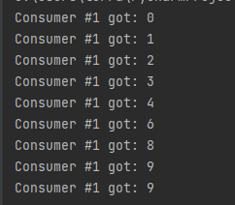
Race Condition
NumberStore
int contents
put(int)
int get()
get()
put()
Consumer
run()
Producer
run()
Producer working Faster
P C
4 4
5
6 6
7
8 8
Start thread
Start thread
Main

Slide 36
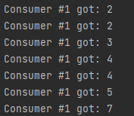
Race Condition
NumberStore
int contents
put(int)
int get()
get()
put()
Consumer working Faster
P C
2 2
2
3 3
4 4
4
5 5
Consumer
run()
Producer
run()
Start thread
Start thread
Main

Slide 37
Race Conditions
Producer Quicker
Consumer Quicker

Slide 38
Synchronizing Producer/Consumer
Monitors
The NumberStore object must be shared between the two threads
Monitor (flag)is a lock on the data.
Critical sections are marked as synchronized
The set() and wait() Methods
These coordinate activity by ensuring that each value placed in the NumberStore by the Producer is consumed once and once only

Slide 39
Solution
class NumberStore:
def __init__(self):
self.contents=0
self.available = False
self.lock1 = RLock()
self.lock2 = RLock()
self.event = Event()
def get(self):
self.lock1.acquire()
while (self.available == False):
self.event.wait()
self.available = False
self.event.set()
self.lock1.release()
return self.contents
def put(self, value):
self.lock2.acquire()
while (self.available == True):
self.event.wait()
self.contents = value
self.available = True
self.event.set()
self.lock2.release()

Slide 40
The set(), wait() Methods
wait()
thread gives up lock (this) and goes asleep
waits until notified of change to current object
set()
wakes up one thread that is waiting on the monitor
Can only be called from synchronized methods or blocks of statements

Slide 41
Exercise : 318
Run Ex318_SkelQ.cs & Observe Race Condition
Implement Changes and notice changed Results
Either: Uncomment Ex318_SkelQ.cs or
Use: Ex318_SolnA.cs

Slide 42
Q319
Bounded Buffer
Now NumberStore has an array of 3 value
After inserting 1,2 After Inserting 3 After deleting 1
NextIn
NextIn
NextIn
1 | 2 | 0
1 | 2 | 3
1 | 2 | 3
NextOut Count=2
NextOut Count=3
NextOut Count=2

Slide 43
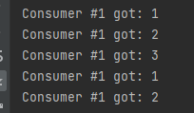
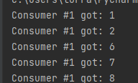
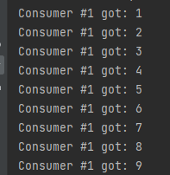
Exercise : 319
Race Condition
Consumer Faster Producer Faster
Modify Numberstore so well behave Expected
Output
If count already 3 producer must wait (Put)
If count equals zero Consumer waits (get)

